Slide 1


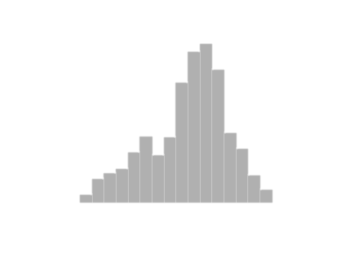
Decision Modeling and Simulation with MCHammer.jl
We want to share how MCHammer.JL can be used to build and analyze Monte-Carlo simulation models with an ease and interactivity similar to Excel. Using core packages such as StatsBase, Statisitics and Distributions.jl we constructed a modeling tool that has charting and all the critical statistics to build and analyze simulation results.
https://github.com/etorkia/MCHammer.jl
Presented by Eric Torkia, MASc
www.technologypartnerz.com

Slide 2
Why Build MCHammer?
Technical Opportunity
Analyst Benefits
Julia is an amazing language for building Monte-Carlo simulations but needed a package to make it simple for analysts making the switch from Excel.
Julia needed an interactive Monte-Carlo tool similar to @RISK or Oracle Crystal Ball.
Speed Matters:
Julia is 750-1500x faster than Excel running similar tasks
API integration makes data acquisition and processing much easier and less error prone.
MCHammer streamlines important analysis into simple functions
Sensitivity Analysis
Histogram and Density Charts
Trend Charts (TimeSeries Confidence)
Fractiles and Certainty Calculations
Measure of correlation
Easy Export to other systerms
Shorter + Flatter learning curve leading to productive models fast.
Fits in the Julia ecosystem

Slide 3
Background
I built MCHammer because I have been working as a Risk and Decision Analyst using Monte-Carlo simulation for 15 years and needed a tool to bridge from Excel to Julia to make models run .
I wanted to bring the experience and the interactive nature of modeling from Excel to Julia for its speed and ability to put models into production
Degree in Management Information Systems and have designed predictive dashboards for clients using Julia+MCHammer with PowerBI as a front end.
I have worked with most of the major vendors to develop features and tools to enhance the modelling process. For many years Our firm was Oracle’s go-to partner for Crystal Ball, a Monte-Carlo add-in for Excel, for training and consulting.

Slide 4
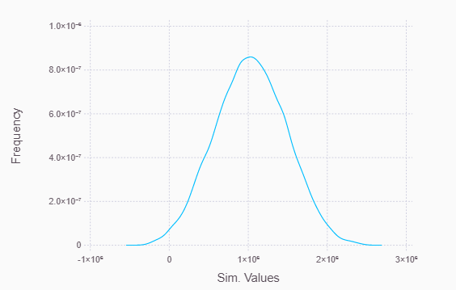
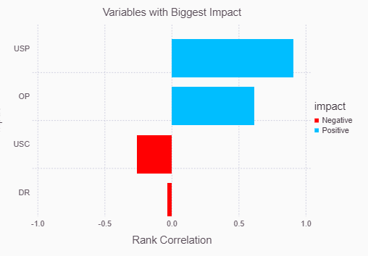
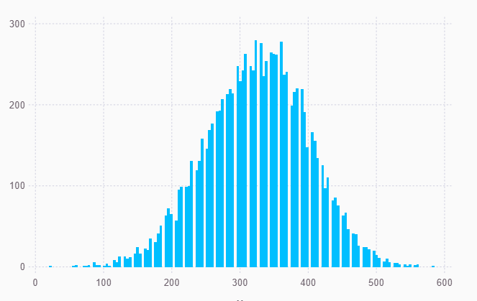
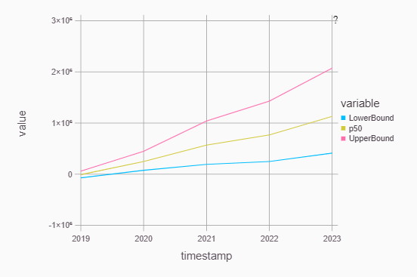
ABSTRACT
Modeling Functions
Random Walk Time Series
GBMM(LastValue, ReturnsMean, ReturnsStd, PeriodsToForecast)
density_chrt(Data, x_label="Sim. Values")
sensitivity_chrt(Trials,1)
Correlating Distributions
corvar(ArrayName, n_trials, correl_matrix)
histogram_chrt(dist, “title")
trend_chrt(SimTimeArray, PeriodRange, quantiles=[0.05,0.5,0.95])

Slide 5
What’s next
Future Work
Implement more time series tools and new stochastic processes such as Markov Chains and Martigales as model building blocks
Implementation of new multidimensional samplers for networked modeling
Implement Ogives and resampling
Mentors and collaborators
A special thanks to Eric Wainwright, co-creator of Oracle Crystal Ball, for technical support and counsel on how to approach feture development and usability
Dr. Sam Savage for his perspective on how simulation results can be shared using the SIPMath standard
Robert D. Brown III for helping implement some of the functions.

